Slide 1
COSC 290 (Lab) #5
Amaizu Gabriel
gamaizu1@students.towson.edu

Slide 2
Circuit Design Tutorial

Slide 3
How to design a logical circuit
Algorithm
Truth table
Karnaugh
Map
Boolean Expression
Circuit Drawing

Slide 4
1) Algorithm Establishment
On the computer programmer’s perspective
boolean input1, input2;
scanf (%d, &input1);
scanf (%d, &input2);
if(input1 == input2)
System.out.println(“output (same)\n”);
else
System.out.println(“(different)\n”);

Slide 5
1) Algorithm Establishment (cont)
On the circuit designer’s perspective
Take two inputs → 1-bit each
Output 1 if the same
Output 0 if different

Slide 6
2) Truth Table Construction
A | B | Out
0 | 0 | 1
0 | 1 | 0
1 | 0 | 0
1 | 1 | 1

Slide 7
3) Karnaugh map
Developed by Maurice Karnaugh in 1953
Description
Transformation of a truth table to extract a boolean expression
Method
Sum of products (Positive logic: e.g., $1=A$ and $0=\overline{A}$)
Product of sums (Negative logic: e.g., $0=A$ and $1=\overline{A}$)
How to build the Karnaugh map
One-on-one relationship between a Karnaugh map and an output
E.g., 3 outputs → 3 Karnaugh maps needed
Conversion to the 2-dimentional graph; X- and Y-axis construction
Categorize inputs to two groups
Placement of outputs to the appropriate cases
Copy outputs from a truth table to its Karnaugh map
The extraction of Boolean expression (Positive logic applied)
Make a product from each output position if its value is 1 and sum all the products.
Note
The output positions can be grouped with the number of $2^{n} \left(n≥0\right).$

Slide 8
3) Karnaugh map (cont)
Boolean expression
Truth table
Boolean expression
A | B | Out
0 | 0 | 1
0 | 1 | 0
1 | 0 | 0
1 | 1 | 1
 | A
B |  | 0 | 1
 | 0 | 1 | 0
 | 1 | 0 | 1

Slide 9
3) Karnaugh map to Boolean Expression
Rules
Adjacent 1s in the K-map represents opportunities to simplify the expression
The minterms for the final expression are found by encircling groups of 1s in the map
Minterm groups must be rectangular and must have an area that is power of 2 (i.e., 1,2,4,8..)
Min term rectangles should be as large as possible without containing any 0s
Groups may overlap in order to make each one larger

Slide 10

4) Boolean Expression Extraction
Boolean expression
Sum of Products (Positive logic: e.g., 1=A & 0=$\overline{A}$)
$∴$ Boolean expressions → Electric circuit diagrams
 | B
A |  | 0 | 1
 | 0 | 1 | 0
 | 1 | 0 | 1
$$P_{1}=\overline{A}∙\overline{B}$$
$$P_{2}=A∙B$$
$$∴Boolean expression=P_{1}+P_{2}=\overline{A}∙\overline{B}+A∙B$$

Slide 11
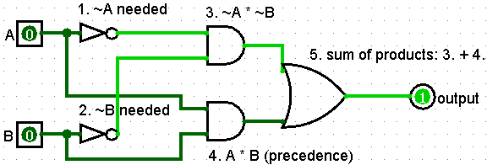
5) Draw the circuit!
$$\overline{A}∙\overline{B}+A∙B$$

Slide 12
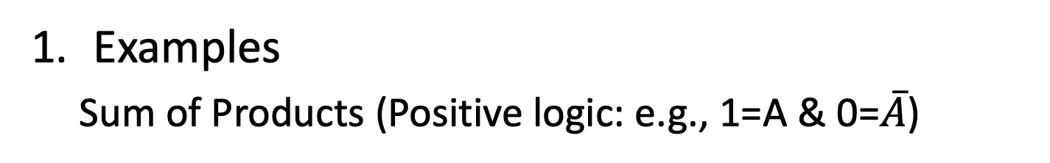
4) Boolean Expression Extraction
Examples
Sum of Products (Positive logic: e.g., 1=A & 0=$\overline{A}$)
 | B
A |  | 0 | 1
 | 0 | 1 | 1
 | 1 | 1 | 1
A B | 00 01 |  | 11 | 10
0 | 1 | 0 | 1 | 1
1 | 0 | 0 | 0 | 0

Slide 13
Practical Example

Slide 14
Let’s think
Build a 1-bit binary adder
0 + 0 = 0
0 + 1 = 1
1 + 0 = 1
1 + 1 = 0 and a carry

Slide 15
Let’s think (cont)
We have two 1-bit binary values for addition:
A | B | S | C
0 | 0 | 0 | 0
0 | 1 | 1 | 0
1 | 0 | 1 | 0
1 | 1 | 0 | 1
S (sum)
 | B
A |  | 0 | 1
 | 0 | 0 | 1
 | 1 | 1 | 0
$$P_{1}=\overline{A}∙B$$
$$P_{2}=A∙\overline{B}$$
$$∴Boolean expression \\ =P_{1}+P_{2}=\overline{A}∙B+A∙\overline{B} \\ =A⊕B$$
C (Carry-out)
 | B
A |  | 0 | 1
 | 0 | 0 | 0
 | 1 | 0 | 1
$$P=A∙B$$
$$∴Boolean expression=A∙B$$

Slide 16


Half Adder
Add two one-bit binary numbers.
INPUT |  | OUTPUT
A | B | S | C
0 | 0 | 0 | 0
0 | 1 | 1 | 0
1 | 0 | 1 | 0
1 | 1 | 0 | 1
 | A
B |  | 0 | 1
 | 0 | 0 | 1
 | 1 | 1 | 0
 | A
B |  | 0 | 1
 | 0 | 0 | 0
 | 1 | 0 | 1
$$S=A∙\overline{B}+\overline{A}∙B$$
$$C=A∙B$$
<Truth Table>
<Karnaugh Map>

Slide 17
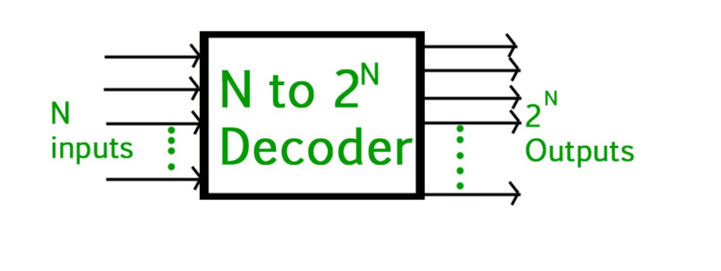
Binary Decoder in Digital Logical
An n-to-m decoder converts inputs into output with multiple bit inputs resulting in 2^n outputs.
The decoder works by producing all possible outputs of 2^n depending on if the input is on or off, producing only one positive output for each unique combination of inputs.

Slide 18
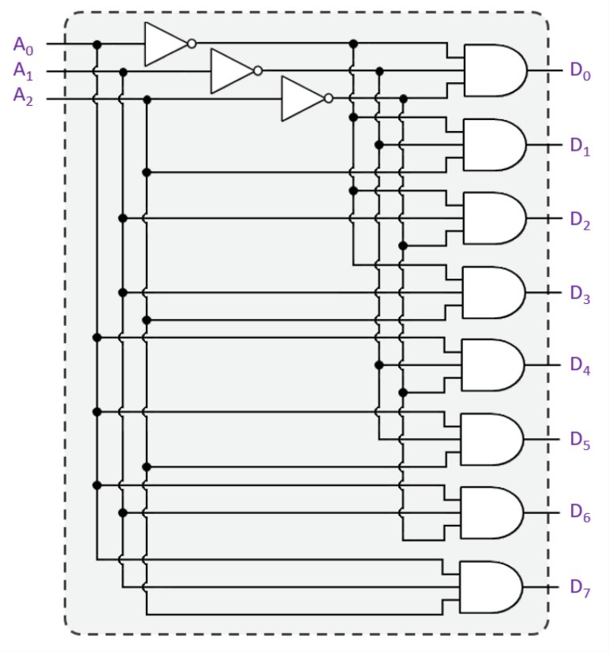
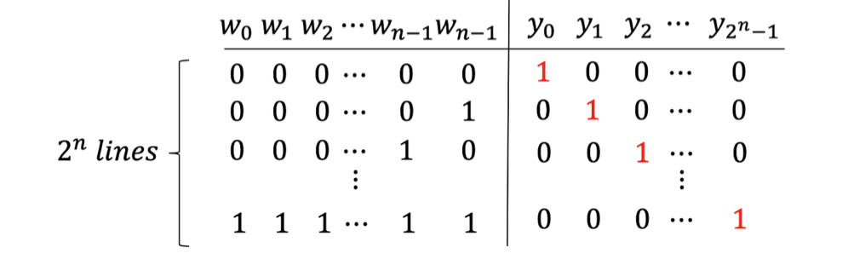
Binary Decoder in Digital Logical

